Slide 1
A Wigner-Eckart theorem for group equivariant convolution kernels
Leon Lang
AMLab, CSL
University of Amsterdam
Maurice Weiler
AMLab, QUVA lab
University of Amsterdam

Slide 2
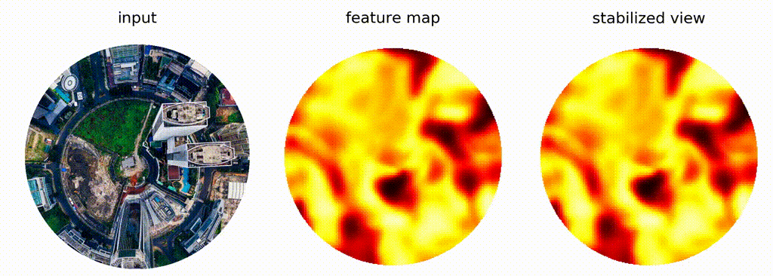
Rotation Equivariant Feature Maps
Visualisation by Gabriele Cesa

Slide 3
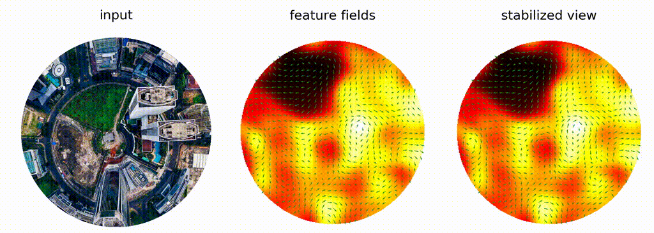
Rotation Equivariant Feature Maps
Visualisation by Gabriele Cesa

Slide 4
The G-Steerability Constraint
Convolution Kernel K

Slide 5
The G-Steerability Constraint
Convolution Kernel K

Slide 6
Quantum operators - Wigner-Eckart theorem
Spherical tensor operators:

Slide 7
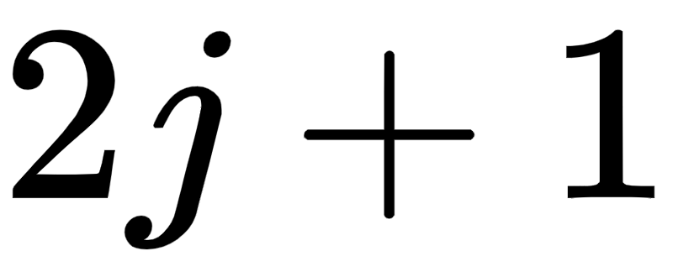
Quantum operators - Wigner-Eckart theorem
Spherical tensor operators:
operators
satisfying symmetry constraint

Slide 8
Quantum operators - Wigner-Eckart theorem
Spherical tensor operators:
operators
satisfying symmetry constraint

Slide 9
Quantum operators - Wigner-Eckart theorem
Spherical tensor operators:
operators
satisfying symmetry constraint
Wigner-Eckart theorem:
the matrix elements for fixed j, l, J are determined by single dof :

Slide 10
Quantum operators - Wigner-Eckart theorem
Spherical tensor operators:
operators
satisfying symmetry constraint
CG-coefficient,
algebraically fixed
Wigner-Eckart theorem:
the matrix elements for fixed j, l, J are determined by single dof :

Slide 11
Quantum operators - Wigner-Eckart theorem
Spherical tensor operators:
operators
satisfying symmetry constraint
CG-coefficient,
algebraically fixed
Wigner-Eckart theorem:
the matrix elements for fixed j, l, J are determined by single dof :
can we generalize this result to the matrix elements of G-steerable kernels?

Slide 12
Wigner-Eckart theorem for G-steerable Kernels
Wigner-Eckart for steerable kernels = explain dof’s in matrix elements of steerable kernels

Slide 13
Wigner-Eckart theorem for G-steerable Kernels
Wigner-Eckart for steerable kernels = explain dof’s in matrix elements of steerable kernels

Slide 14
Wigner-Eckart theorem for G-steerable Kernels
Wigner-Eckart for steerable kernels = explain dof’s in matrix elements of steerable kernels
Peter-Weyl Theorem

Slide 15
Wigner-Eckart theorem for G-steerable Kernels
Wigner-Eckart for steerable kernels = explain dof’s in matrix elements of steerable kernels
2. Clebsch-Gordan decomposition
Peter-Weyl Theorem

Slide 16
Wigner-Eckart theorem for G-steerable Kernels
Wigner-Eckart for steerable kernels = explain dof’s in matrix elements of steerable kernels
3. Irrep endomorphisms
2. Clebsch-Gordan decomposition
Peter-Weyl Theorem

Slide 17
Wigner-Eckart theorem for G-steerable Kernels
Wigner-Eckart for steerable kernels = explain dof’s in matrix elements of steerable kernels
There are steerable basis kernels such that:

Slide 18
Wigner-Eckart theorem for G-steerable Kernels
Wigner-Eckart for steerable kernels = explain dof’s in matrix elements of steerable kernels
There are steerable basis kernels such that:

Slide 19
Wigner-Eckart theorem for G-steerable Kernels
Wigner-Eckart for steerable kernels = explain dof’s in matrix elements of steerable kernels
There are steerable basis kernels such that:
Learnable Parameters

Slide 20
Example Applications

Slide 21
Example Applications
SO(2) with complex representations [1]​
[1] Daniel E. Worrall et al. (2016). “Harmonic Networks: Deep Rotation and Translation Equivariance” In: Conference on Computer Vision and Pattern Recognition (CVPR)​

Slide 22
Example Applications
SO(2) with complex representations [1]​
SO(2) with real ​representations [2]​
[1] Daniel E. Worrall et al. (2016). “Harmonic Networks: Deep Rotation and Translation Equivariance” In: Conference on Computer Vision and Pattern Recognition (CVPR)​
[2] Maurice Weiler, Gabriele Cesa (2019). “General E(2)-Equivariant Steerable CNNs” ​
In: Conference on Neural Information Processing Systems (NeuRIPS)​

Slide 23
Example Applications
SO(2) with complex representations [1]​
SO(2) with real ​representations [2]​
SO(3) with complex and real representations [3, 4]​
[1] Daniel E. Worrall et al. (2016). “Harmonic Networks: Deep Rotation and Translation Equivariance” In: Conference on Computer Vision and Pattern Recognition (CVPR)​
[2] Maurice Weiler, Gabriele Cesa (2019). “General E(2)-Equivariant Steerable CNNs” ​
In: Conference on Neural Information Processing Systems (NeuRIPS)​
[3] Nathaniel Thomas et al. (2018). “Tensor Field Networks: Rotation- and Translation-Equivariant Neural Networks for 3D Point Clouds” In: arxiv e-Prints​
[4] Maurice Weiler et al. (2018). "3D Steerable CNNs: Learning Rotationally Equivariant Features in Volumetric Data." In: Conference on Neural Information Processing Systems (NeuRIPS)​

Slide 24
Example Applications
SO(2) with complex representations [1]​
SO(2) with real ​representations [2]​
SO(3) with complex and real representations [3, 4]​
with real (regular) representations [5]​
[1] Daniel E. Worrall et al. (2016). “Harmonic Networks: Deep Rotation and Translation Equivariance” In: Conference on Computer Vision and Pattern Recognition (CVPR)​
[2] Maurice Weiler, Gabriele Cesa (2019). “General E(2)-Equivariant Steerable CNNs” ​
In: Conference on Neural Information Processing Systems (NeuRIPS)​
[3] Nathaniel Thomas et al. (2018). “Tensor Field Networks: Rotation- and Translation-Equivariant Neural Networks for 3D Point Clouds” In: arxiv e-Prints​
[4] Maurice Weiler et al. (2018). "3D Steerable CNNs: Learning Rotationally Equivariant Features in Volumetric Data." In: Conference on Neural Information Processing Systems (NeuRIPS)​
[5] Taco Cohen, Max Welling (2016). "Group Equivariant Convolutional Networks." In International Conference on Machine Learning (ICML)

Slide 25
Example Applications
SO(2) with complex representations [1]​
SO(2) with real ​representations [2]​
SO(3) with complex and real representations [3, 4]​
with real (regular) representations [5]​
O(3) with both complex and real representations​
[1] Daniel E. Worrall et al. (2016). “Harmonic Networks: Deep Rotation and Translation Equivariance” In: Conference on Computer Vision and Pattern Recognition (CVPR)​
[2] Maurice Weiler, Gabriele Cesa (2019). “General E(2)-Equivariant Steerable CNNs” ​
In: Conference on Neural Information Processing Systems (NeuRIPS)​
[3] Nathaniel Thomas et al. (2018). “Tensor Field Networks: Rotation- and Translation-Equivariant Neural Networks for 3D Point Clouds” In: arxiv e-Prints​
[4] Maurice Weiler et al. (2018). "3D Steerable CNNs: Learning Rotationally Equivariant Features in Volumetric Data." In: Conference on Neural Information Processing Systems (NeuRIPS)​
[5] Taco Cohen, Max Welling (2016). "Group Equivariant Convolutional Networks." In International Conference on Machine Learning (ICML)

Slide 26
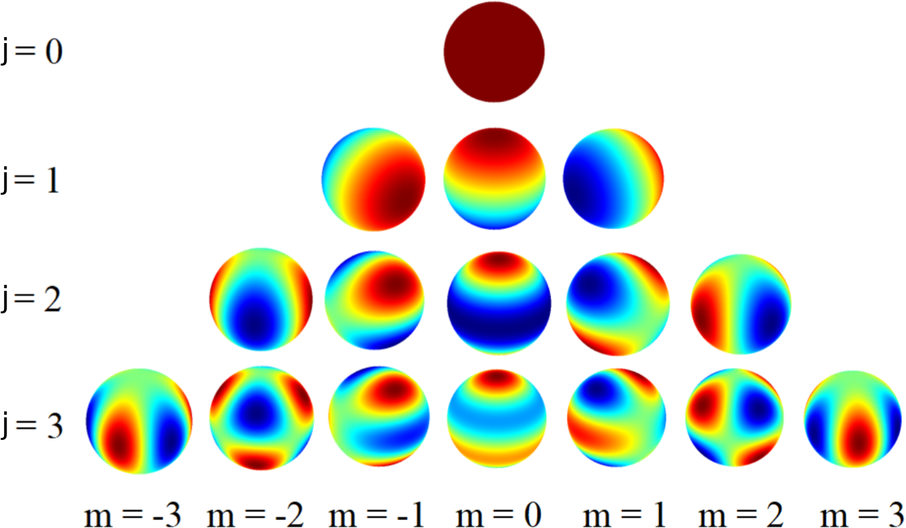
Example Applications
Circular harmonics
SO(2) with complex representations [1]​
SO(2) with real ​representations [2]​
SO(3) with complex and real representations [3, 4]​
with real (regular) representations [5]​
O(3) with both complex and real representations​
Spherical harmonics
[1] Daniel E. Worrall et al. (2016). “Harmonic Networks: Deep Rotation and Translation Equivariance” In: Conference on Computer Vision and Pattern Recognition (CVPR)​
[2] Maurice Weiler, Gabriele Cesa (2019). “General E(2)-Equivariant Steerable CNNs” ​
In: Conference on Neural Information Processing Systems (NeuRIPS)​
[3] Nathaniel Thomas et al. (2018). “Tensor Field Networks: Rotation- and Translation-Equivariant Neural Networks for 3D Point Clouds” In: arxiv e-Prints​
[4] Maurice Weiler et al. (2018). "3D Steerable CNNs: Learning Rotationally Equivariant Features in Volumetric Data." In: Conference on Neural Information Processing Systems (NeuRIPS)​
[5] Taco Cohen, Max Welling (2016). "Group Equivariant Convolutional Networks." In International Conference on Machine Learning (ICML)

Slide 27
A Wigner-Eckart theorem for group equivariant convolution kernels
Leon Lang
AMLab, CSL
University of Amsterdam
Maurice Weiler
AMLab, QUVA lab
University of Amsterdam

